Slide 1
Managing Talent in a Candidate Driven Market
In the Post-Pandemic Workforce
Megan Graham
Director of Professional Staffing
Find Great People

Slide 2
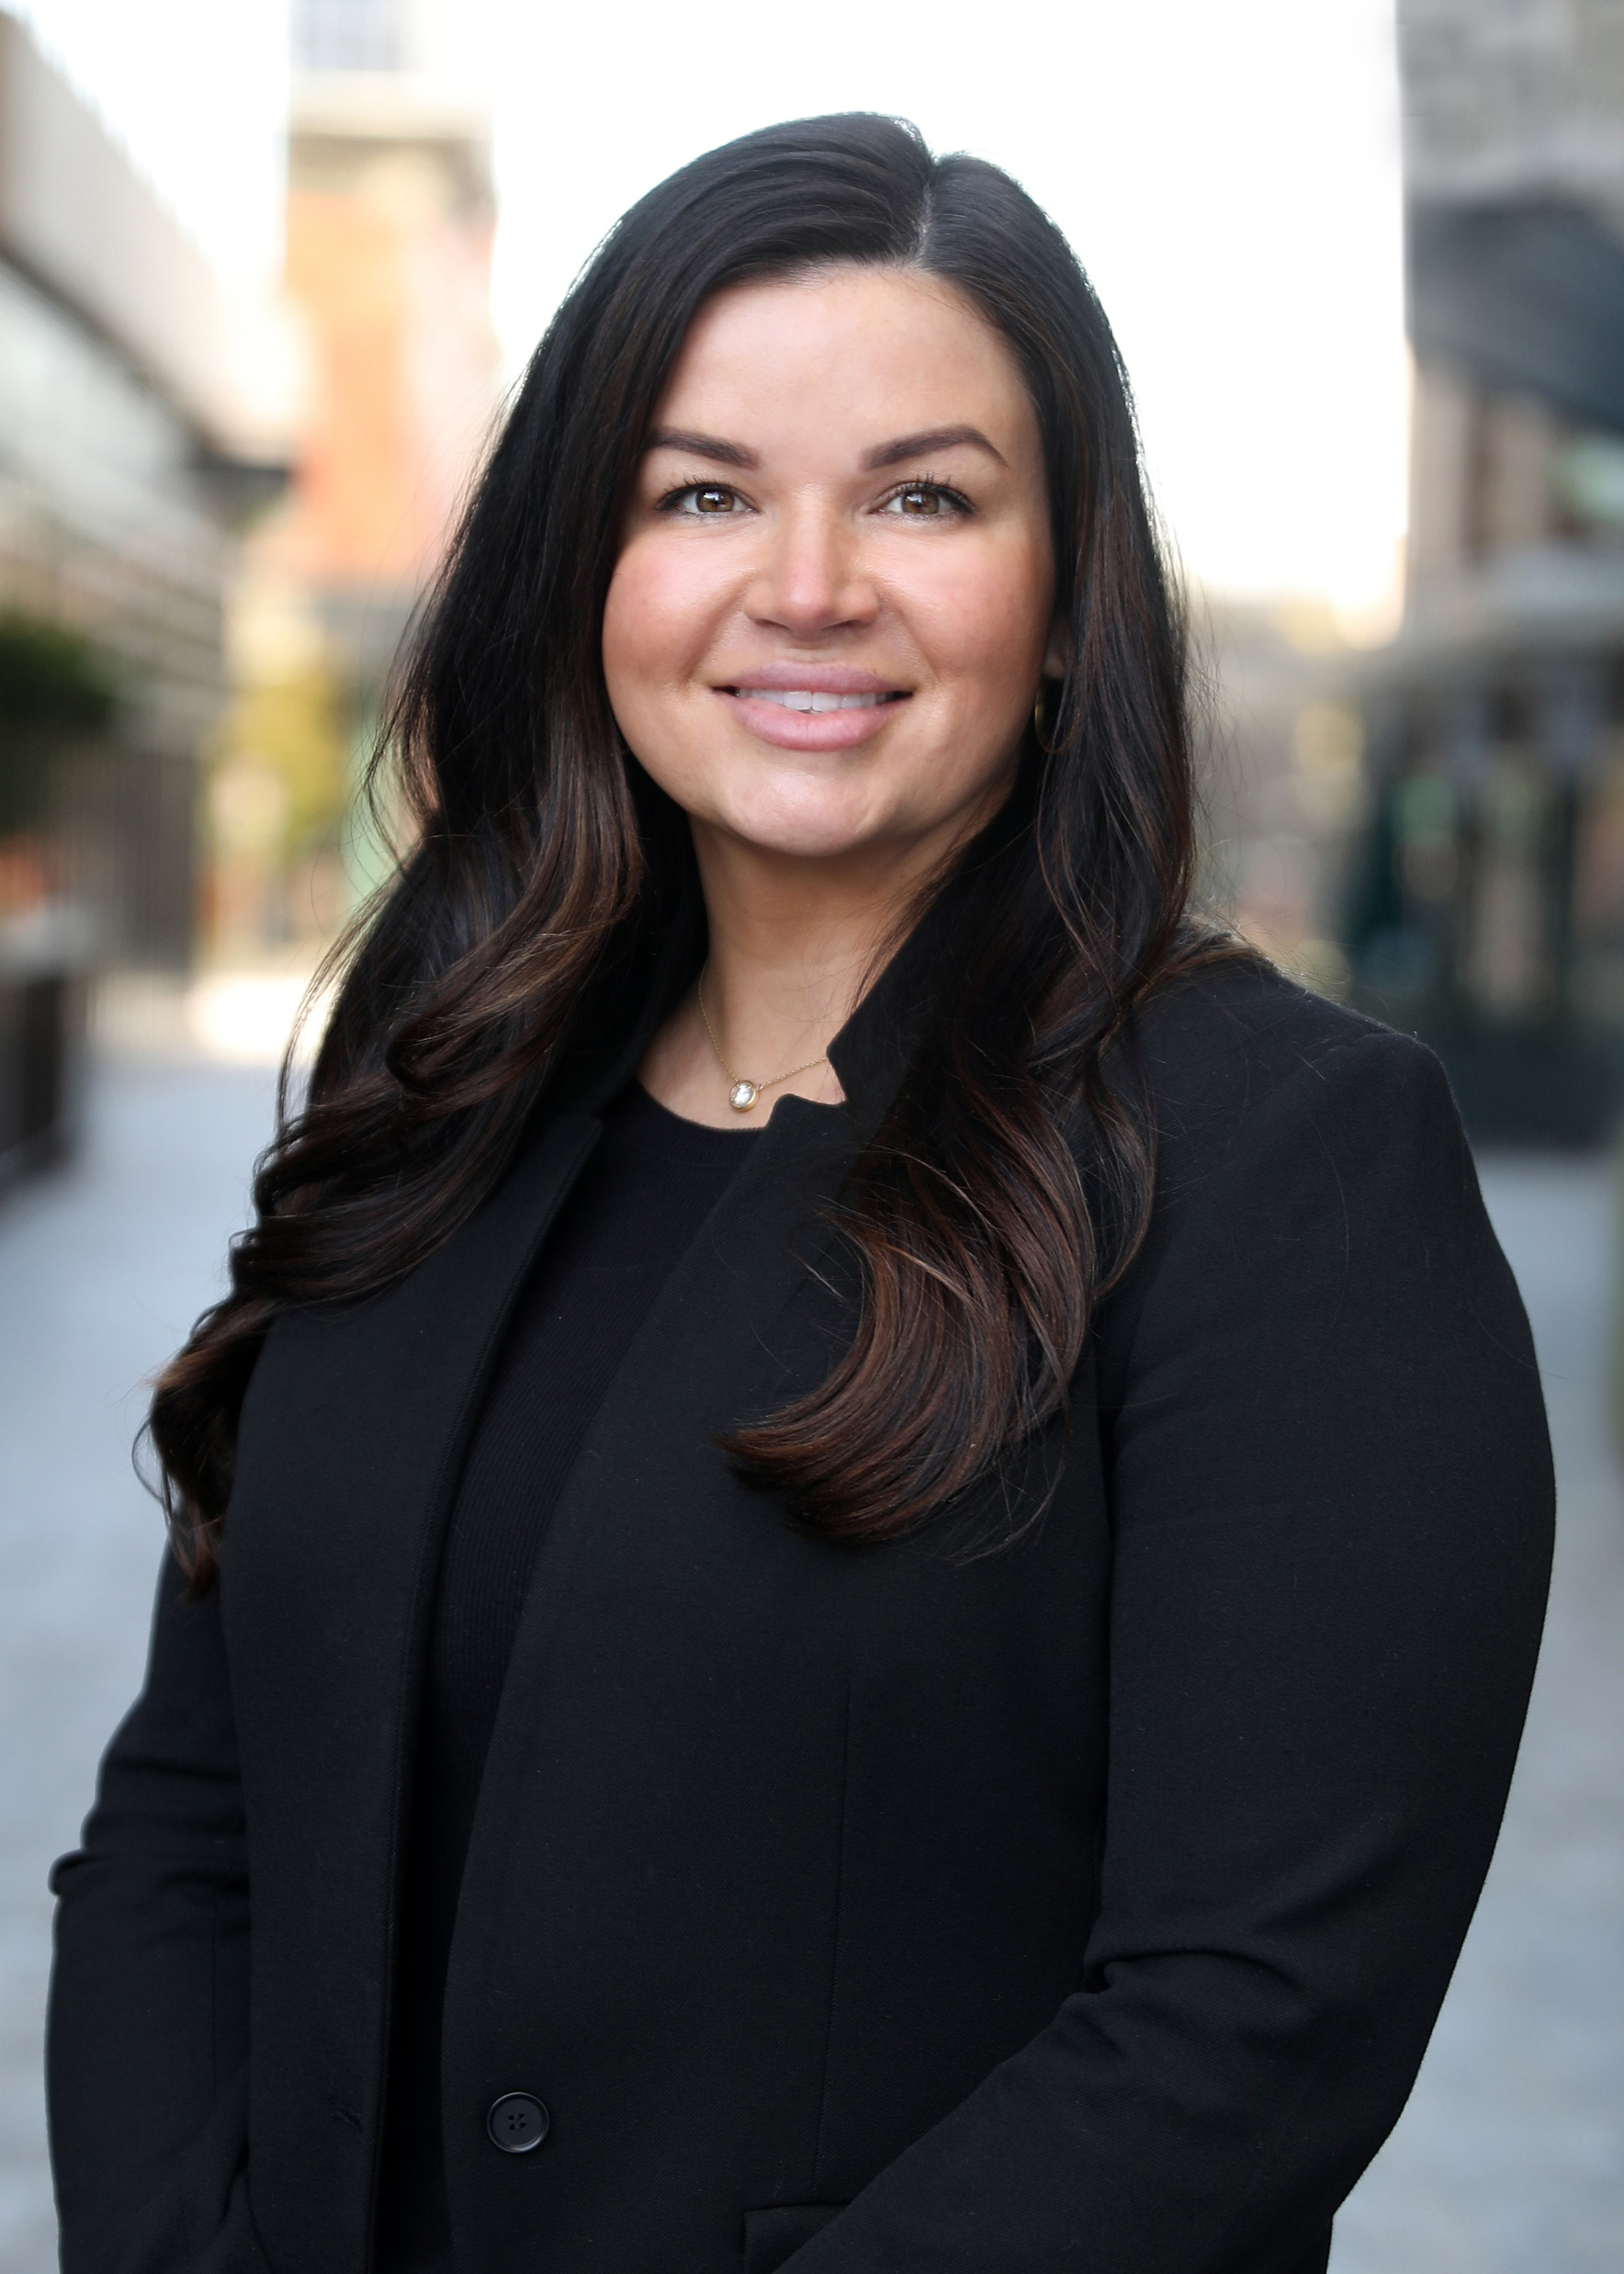
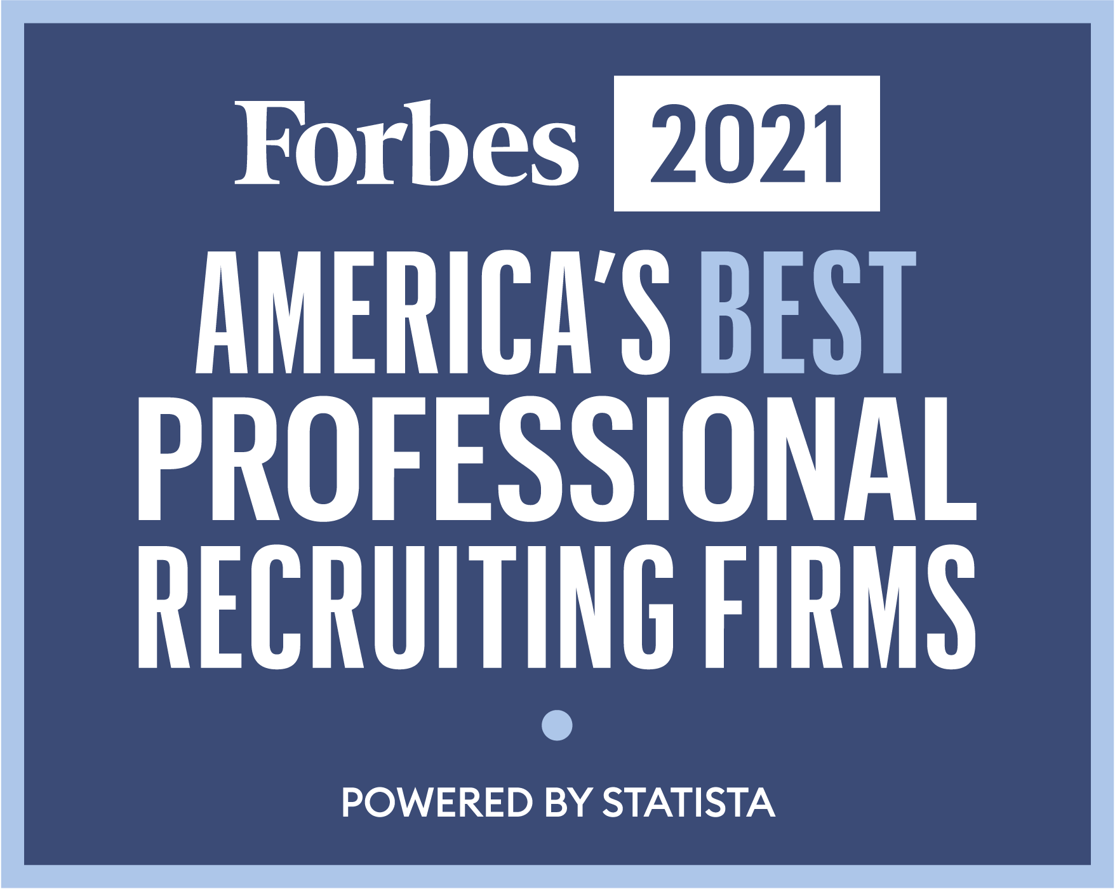
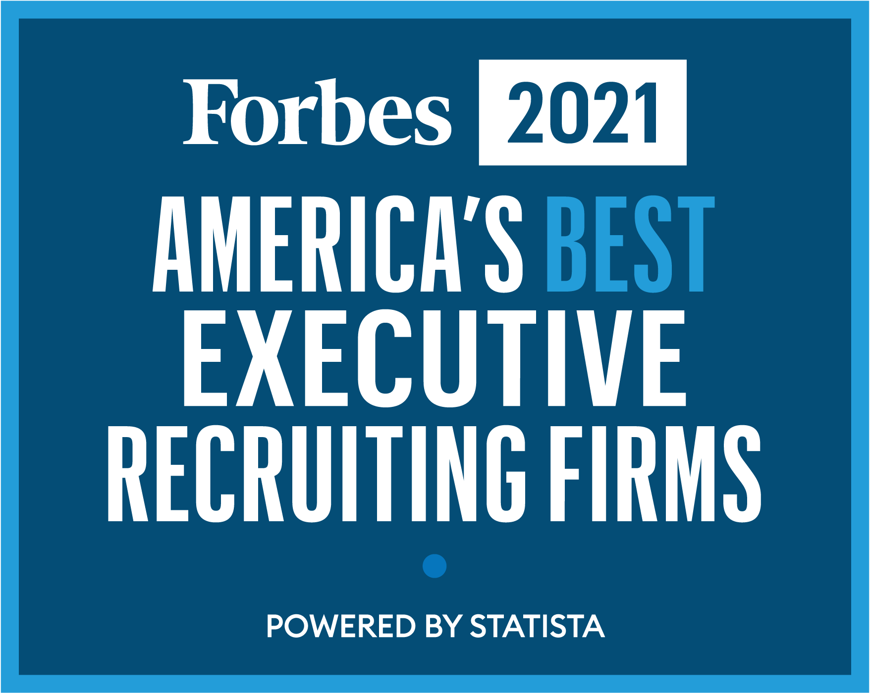
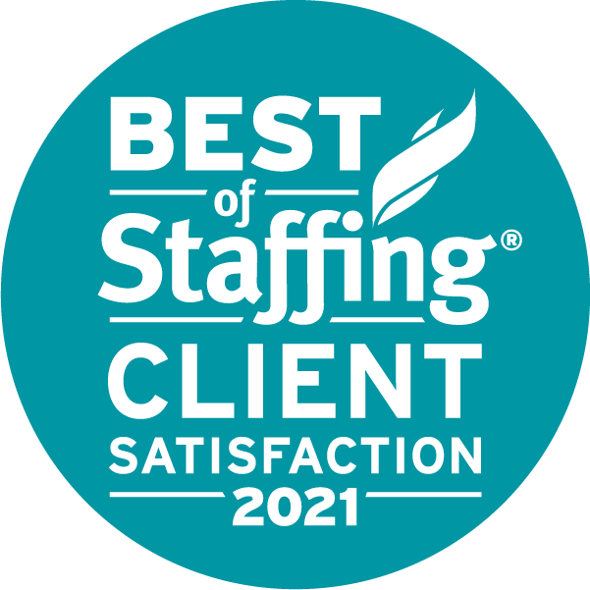


Megan Graham
Director of Professional Staffing
Joined FGP in 2017 as an Executive Search Consultant
Almost 15 years in the recruiting industry
Member of the Executive Leadership Team, leading company growth and strategy
Recognized as a Best Recruiting Firm by Forbes for the last 4 years.

Slide 3
EMPLOYEE RELATIONS & TALENT PLAN:
BEST PRACTICES
Navigating an alternative work force model
Managing Covid/Vaccine guidelines
Creating and maintaining a winning culture
Finding and transitioning talent

Slide 4
WORK FORCE MODEL:
REMEMBER THE PAST AND EMBRACE THE FUTURE
What really matters when it comes to ensuring success?
  Connectivity
  Intentionality v. Physicality
Mindset
  Why it won’t work v. how we make it work
  Be flexible as often as you are able, no “one size fits all” approach
  If you have hired the right people, this will drive buy-in and allow your teams to be seen, heard and feel valued

Slide 5
MANAGING COVID GUIDELINES: COMMUNICATION IS KEY
Create an external focus, limit internal focus:
  Communicate early and often with your plan
  Be concise, informative and fair
  Engage internal core team members prior to company wide delivery
  Seek to listen and understand when feedback is offered
  Keep focus on your “why” as an organization

Slide 6
ACQUIRING AND RETAINING TALENT:
CREATE AND MAINTAIN A WINNING CULTURE
ACQUIRING TALENT:
SOURCING
  Internal referrals, job boards and external recruiting resources
SPEED
  With the tightness of the candidate market, pace while interviewing is important, moving quickly secures talent.
COMPENSATION
  Companies are paying more for talent today than they did 18 months ago
    Consider internal equity when making compensation decisions
  Counteroffers are expected in our current market – be prepared
    Proactively ask your top two candidates how they would handle a counter-offer from their current employer

Slide 7
ACQUIRING AND RETAINING TALENT:
CREATE AND MAINTAIN A WINNING CULTURE
RETAINING NEW TALENT:
A more comprehensive, intentional onboarding program is key to retaining new team members:
  More than 1 day to 1 week, think integration to the position, team and company
    Schedule in person onsite time (culture, people, customers)
    Ensure you have a technical and culture components built into the program
    Assign an onboarding buddy or mentor for the new team member

Slide 8
RETAINING TALENT: RETENTION STRATEGY
BEST PRACTICES
INTENTIONAL TIME
APPRECIATION
SOCIAL COHESION

Slide 9

Intentional Time
Maintain a discipline on employee meetings and communication. Company-wide meetings are important, but individual ones are essential.
Have more than meetings. Dive deeper – what’s going on outside of work?
Hold listening sessions. They are easily accomplished, insightful, and employees feel heard.
Notes:
Maintain a discipline on employee meetings and communication. These can be companywide meetings, but the most important meetings are individual meetings between managers and employees. Regardless of the whirlwind of the day to day, get them scheduled, prioritize them and most importantly, be present.
Have more than meetings. Life isn’t just about “what is going on at work.” Be sure to ask about what is going on outside of work. If employees have challenges at home, they will follow them into the workplace. Relationships between employees and companies are holistic. Employee meetings should be as well.
Employees equate “being heard” with care and inclusion. In addition to individual employee meetings, hold listening sessions. These are most effective in small group settings and can be done in person or virtually. It allows senior leaders to engage with employees, ask questions and receive feedback. These are easily accomplished and very insightful.

Slide 10
Appreciation
Hand-written notes. They are a lost art - try to bring them back.
Peer to peer recognition programs. Creating a space to say thank you creates a culture where appreciation is free flowing and genuine.
Share success stories. Do you have stories about how your employees are making a difference? Share them. It makes your team feel more connected to a bigger purpose and drive fulfillment.
Notes:
Appreciation: people crave it, especially when they don’t expect it. The desire for a kind word or to experience gratitude doesn’t have boundaries or limitations. Words build self-esteem, confidence, hope in people and strengthen the relationship between the employee and the company. Some simple ways to make appreciation a permanent part of your culture:
A lost art and way to communicate is the hand-written note. In the age of technology, e-mails have become the most frequently used communication medium at work and at home. When an employee receives a hand-written note at home from their boss with an expression of appreciation, it has lasting impact. Even better, other members of the family get to have awareness of and share in the recognition. If your handwriting is terrible, that’s okay. Just send a quick text or give the employee a call. The key is to be consistent in showing appreciation or recognition with your words or actions and doing it when it is unexpected!
Peer-to-peer recognition programs are non-monetary and proven to be very effective. When a co-worker takes time out of their day to recognize the hard work of their peer, it goes a long as an organization, give your employees the tools, programs, and space to say thank you more frequently to each other. This is one of many steps towards creating a culture where recognition is free flowing and allows the genuine spirit of collaboration and gratitude to be felt by all.
Share success stories. These stories don’t have to just be about a big sale, or a job well done. They can be more meaningful, showcasing how the work your employees are doing contributes to a bigger definition of success. It aligns people on values, purpose and drives fulfillment knowing that they are part of a team that makes a difference. These stories can be told in writing via blog, on a video that can be posted on your website or in a larger company meeting. Recognition moments are there, you just must find them and encourage people to share.

Slide 11
Social Cohesion
First Five. Take the first five minutes of a meeting to allow employees to share an experience or update from outside of work.
Social Experiences. These can range from book clubs, to workouts, or even happy hours. The key is that employees are doing things together.
Video Message from Leadership. Everyone gets emails from members of the leadership team regarding updates. Why not try a video update instead? Keep it short, but rich in content.
Notes:
Social cohesion. We all have a desire to feel that we are part of something bigger. Where someone works is a part of their identity and should be a place where they find fellowship and community. In our post COVID world of remote work with less in-person time together, this takes creativity and intentionality. Here are some best practices for promoting social cohesion in a virtual world:
“First Five”: in addition to ensuring people have their cameras on for the video meeting, take the first five minutes to allow people to share an experience or update from outside of work. Based upon the meeting flow, frequency, and size of group, it can be incorporated as a meeting norm. Five minutes compounded across hundreds of meetings over the course of a year is an easy way to promote interaction and connection between employees.
Virtual Social Experiences (VSE): these can range from book clubs to virtual fitness or a happy hour at the end of the day. A good way to get VSEs started are to reach out to employees, ask them what they want and give them the authority to put these in place. A little organizational support around VSEs can go a long way. The key is that employees are doing things together.
Video Messages (Leadership): employees have a greater appetite in the post COVID world for hearing about a company’s direction, performance, or challenges. Alternative communications are pivotal in creating connection and social cohesion. A simple one-to-two-minute video from the CEO or other senior executive to the workforce or team can be very effective. Make it informal, but rich and specific in content and message.

Slide 12
HOW CAN
FIND GREAT PEOPLE
HELP?

Slide 13
SUCCESS
STARTS WITH GREAT PEOPLE.
Our purpose is to build great companies through great people. Whether it’s finding or growing people, we help you achieve great. We are focused on growth and grounded in gratitude.
Staffing
Search
Consulting

Slide 14

Megan Graham
Director of Professional Staffing
mgraham@fgp.com
803-719-5544

