Slide 1
Finding Success & The Energy to Lead in Chaos

Slide 2
Quick tip while you’re hear: Remember to QC your “paperwork” workflow
Moving your hiring process to remote interviewing may require a change in how you share and process the application and onboarding paperwork. Check these points in your workflow:
Maintained access to your Job Ad responses
Maintained access to your online application
Ability to share and keep resumes if the ATS is not accessible, such as SharePoint and OneNote
Wet signature documents get moved to a “docu-sign” tool
I9 remote processing should be a documented process. There are services and software available for purchase to assist with remote I9’s.

Slide 3
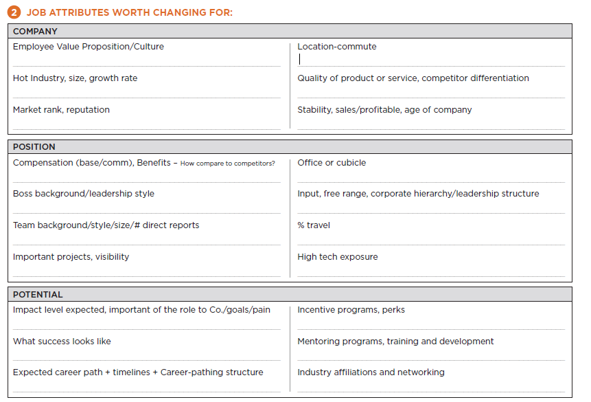
WIFM: What’s In It For Me?

Slide 4
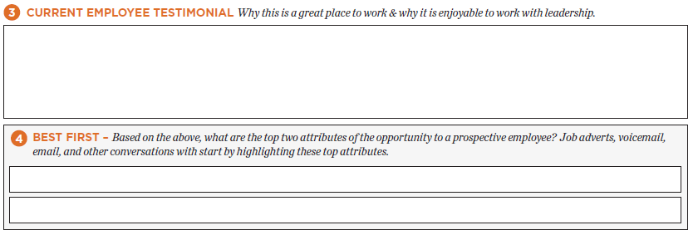
WIFM: What’s In It For Me?

Slide 5
Employers Cannot Afford Slow Hiring
$500+
Typical Cost of Vacancy Example
Annual Salary | $50,000
Productivity Multiplier | X 3
Annual Contribution | = $150,000
Annual Work Days | 244
Daily Cost of Vacancy | = $615
Days to Fill | X 30
Total Cost of Vacancy | = $18,450
Per day average
Cost of unfilled positions
according to most employers
30+
day average
Average time employers need to fill an open position
Calculate Your Specific COV
Click Calculator to Open Now

Slide 6
Practice Webcam and/or Video Calls
Staying connected is vital
to morale and productivity.
Based on the available technology, start a routine with staff that incorporates video meetings and calls. Defer to your IT department for your options if you do not already have a “virtual” habit. MS Teams is a well rounded and easy to use option for seemingly all of our remote team needs.
Other telecommuting tools to stay connected:
Instant chat: Slak, HipChat, MS Teams Chat
Collaboration: Basecamp, Trello, Skype, OneNote, SharePoint, MS Teams Planner
Video calls and group video meetings: Skype, Go-to-Meeting, WebEx, MS Teams
Document Sharing: Dropbox, SharePoint, OneNote, MS Teams Documents
If staff have a webcam on their home computers, it is best for senior managers to have a daily virtual meeting with staff and a weekly virtual meeting with their supervisors.

Slide 7
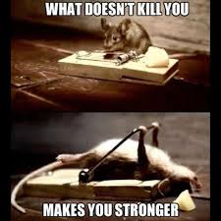
#1 Be gentle with change
If working from home is going to be new for anyone, keep in mind that change can be hard on some people, even our leaders.
Even the seemingly simplest of procedures may need to be outlined.
Sometimes being helpful isn’t helpful. It’s possible to be providing too much how-to information too soon. Space out informative communications. If you can, pick someone to be a source of funneling the information to avoid overlapping or contradicting.

Slide 8
Culture & Engagement
Meet as a team to discuss and document your pledge to maintain your mission and values, and what it will look like when telecommuting. Create common rally-cry language to boost communications amongst each other.
What is your narrative for your team?

Slide 9
Culture & Engagement
It's easy for remote team members to feel isolated from the rest of the work group, particularly if multiple individuals are telecommuting from home or from individual offices. Minimize the possibility of isolation by encouraging team communication and activities.
Implement team chat rooms and encourage team members to share highpoints, solutions, tips, and memes throughout the week. Just be upfront that the tone is optimistic and productive.
Steer the team away from sharing what’s in the news, as it often creates a distraction.
Is someone available to send kudo/shout-out emails during the week to the team?
To support shout-outs and appreciation, collect a supply of saved images, motivational quotes, and memes to be ready to go.

Slide 10
Culture & Engagement
One advantage for hiring talent into a remote team is that you are not limited to candidates that live near an office location. You can simply hire the best candidate. That still doesn't mean that hiring isn't competitive - and companies need all the help they can get.

Slide 11
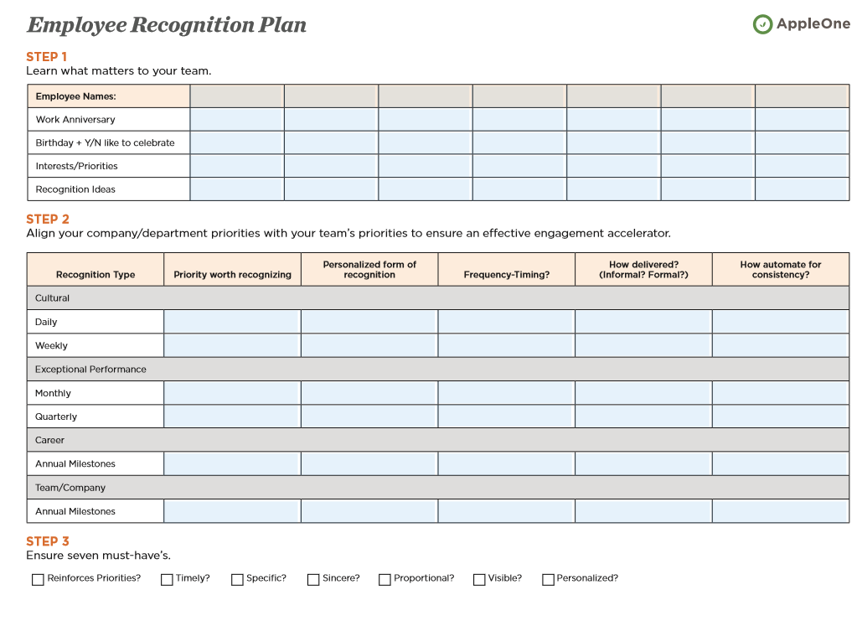

Slide 12
Best Practices
If your team has a tradition of celebrating birthdays or anniversaries, plan to keep the tradition going.
We enjoy celebrated as a team on webcam. We’ve all had lunch virtually together. We’ve made fun signs and sometimes dressed up in fun apparel to keep each other smiling.
Cards that the team can all sign make a great impression on people. We love: https://www.kudoboard.com/

Slide 13
Have Fun!
Here are some team activities that can be done remotely:
Virtual polls or Jeopardy quizzes
Virtual gaming activities like Words with Friends
Virtual charades
Virtual contests like internet scavenger hunts
Here are easy to use links to game/quiz makers:
https://jeopardylabs.com/
https://www.onlinequizcreator.com/

Slide 14
Thank you for your time! www.appleone.com/Employers/SCALE/2020/ www.appleone.com/Career_Seekers/nhp/

